Slide 1

AI Value & Business Case
Module #02 – AI Role in Business
Notes:
Module #02 tackles the role of artificial intelligence (AI) in business and its influence in the decision-making process

Slide 2
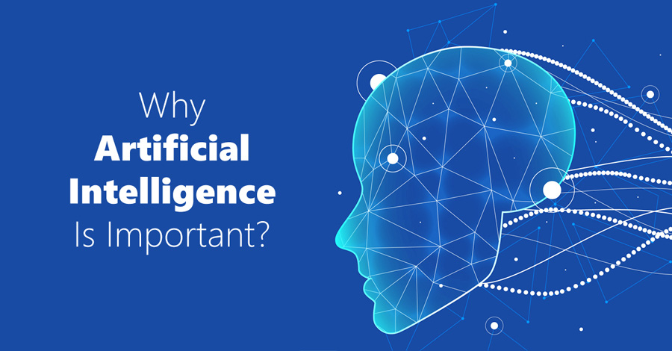

Notes:
KLP: Get from the audience what they think AI is.
So why AI is so important for us?
Let us have a small discussion on this, in our audiences why do you think AI is important or you think AI is important at all.
Get some feedback from the audience and write down the responses in the white board.
Thank the audience for the feedback and indicate that all of them got it right, with a good understanding from the audience.
If we summarize your understanding in a sentence it should say: [click]
Next slide

Slide 3

AI is the latest technology that augments decision making process.
Notes:
KLP: Present the definition of AI.
AI is a technology that follows a process of workflow that helps decision making process.
In other words, AI puts decision making at an all NEW level!!!
Next slide

Slide 4

Where do we Run
AI
For Decision
Making
Notes:
KLP: Understand that AI applies on all sectors of the economy that affects life.
Before we dive into decision making process, let us see the business areas where in fact AI is a valuable tool to make critical decision that affects life.
In other words, where AI help us in the decision-making process.
Next slide.

Slide 5


Surveillance
Infrastructures
Real Estate
Transportation
Retails
Roads & Highways
Manufacturing
House
holds
Industries
Health
Care
Agriculture
IT
AI Business Value?
ALL Economy Sectors!!!
Renewables
Education
Power
Communication
Notes:
KLP: Understand that AI applies on all sectors of the economy that affects life.
Critical decision-making, from management to worker level, are made EVERYDAY in every field, sector, or industry in the economy.
[click to trigger animation]
from households, retails, real estates ….(read as name pops).
And those decisions are so critical that affects throughout the life of this earth.
Next slide

Slide 6
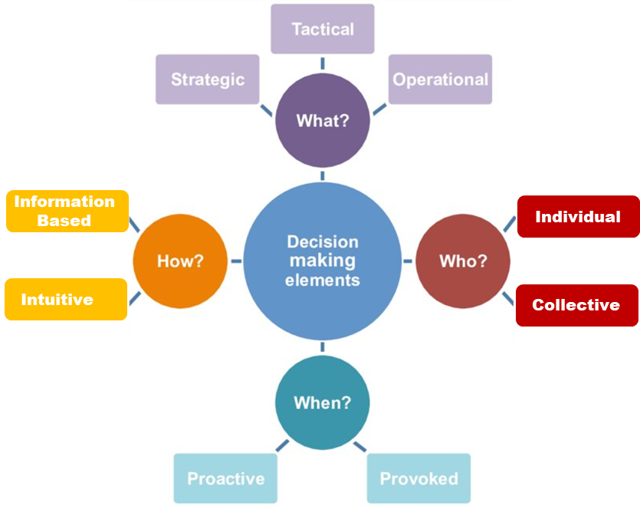
Decision Making??
Process to choose between alternatives when
tackling a problem
Notes:
KLP: Understand WHAT is decision-making: a process to choose between alternatives as well as the ELEMENTS involved.
Let us tackle now a little bit on DECISION MAKING.
Ask the audience WHAT DO YOU THINK DECISION IS?
Potential responses include:
Choose between alternatives
Define what is better or worse
Decide which option is better
But HOW do you CHOOSE between alternatives?
Balance between pros and cons
Windsom
Break down the alternatives in smaller elements and see the alternatives
Write down all the responses, and state that we all have a good idea of WHAT decision-making is.
However, in this course, we need to look on the different ELEMENTS of the decision-making process and see how AI can help us.
For that, we will use the following statement to define decision-making [click]:
Decision-making is a PROCESS we use to choose between different options or alternatives when trying to solve a problem.
[Click] These are the ELEMENTS involved in the decision-making process, which respond to the following questions:
WHAT
WHO
WHEN
HOW
Let’s tackle EACH of these questions separately [click]

Slide 7
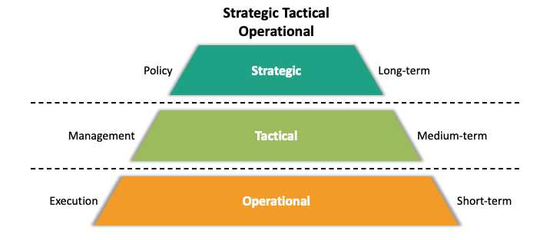
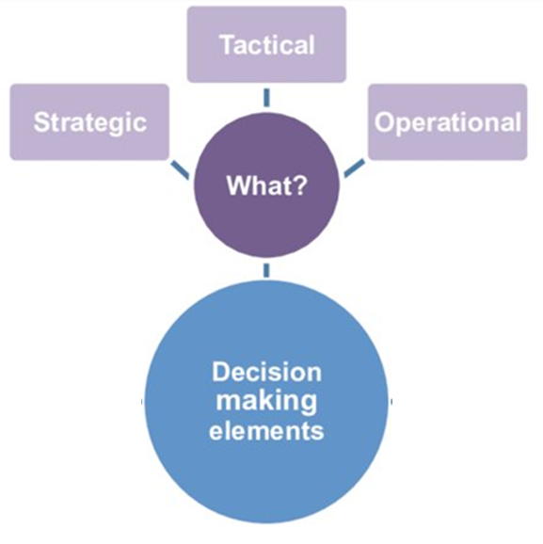
Example #2
Healthcare: Manage Disease Spread
Infrastructure location and player age capacity development (STRATEGIC)
Socio economic and Environmental Perspective
Targeted preventive measures in locations or beneficiaries
Targeted Infrastructure development and fund distribution (TACTICAL)
Monitor Disease Progression, Hospital Preparedness, Manage supplies etc.
Monitor Progress, Diagnose Problem, solve and appropriate fund (OPERATIONAL)
EXAMPLE #1
Football Capacity Improvement
What?
AI follows the money!!
Notes:
KLP: Understand the first element in the decision-making process: WHAT
When we are answering WHAT in the decision-making process, we need to differentiate between strategic, tactical and operational.
[Click]
STRATEGIC is the light at the end of the tunnel (LONG TERM), what we want to be and where we are going, and at organization level it is related to POLICES. It basically responds to WHY.
TACTICAL is what we do to see the light at the end of the tunnel, the different processes (MANAGEMENT) we use, all in the MID-TERM. It basically responds to WHAT.
OPERATIONAL is the day to day (SHORT TERM) execution, based on the tactical processes to achieve our strategic goal. It responds to HOW.
Let us put a couple of examples to understand this better
[Click]
The first one is about football. I am particularly a soccer maniac!!! By the way as you know I am from Argentina and Diego Maradona is my distant relative as my name is Diego also, so I can give some advise on improving Bangladesh football structure.
Suppose Bangladesh wants to improve its rank in football, but they have limited resources, so Bangladesh Football Federation (BFF) must make a STRATEGIC decision to WHERE certain infrastructure must be developed, and which age of players (WHO) must be considered.
The next level could be to make a TACTICAL decision on what type of infrastructure it needs to developed such as soccer schools, and where funds should be allocated, who or what organization is going to manage the process, etc.
Finally, in the last level, we have built the infrastructure and we are EXECUTING what we planned. THE BFF must now make OPERATIONAL decisions such as monitoring the improvement, progress, diagnose the problem, redistribute fundings, etc..
[click]
One thing to remember regarding funding is that involves everything and that is where the use of AI come fruitful as AI follows the money.
Let us have another example related to Bangladesh.
[Click]
Suppose the Health Ministry wants to manage a spread disease, such as dengue, COVID, or malaria, or even ALL THREE together, as for example IDARE did for the Bangladesh government in 2020.
The STRATEGIC decision was to focus more on the socio-economic and environmental perspective, as follows:
Socio-economic was oriented to improve people’s quality of life by:
improving healthcare,
providing financial help or
increase awareness etc.
Environmental was oriented on improving the environmental conditions, such as:
Mosquito treatment
Avoid outdoor water ponding
Increase awareness such as washing hands periodically.
The TACTICAL decision was to differentiate between:
Group of people
Available infrastructure
Treatment locations, etc.
Then, at OPERATIONAL level we concentrated on date regarding:
Diagnosis and monitoring,
Tracking disease progression,
How to prepare your hospitals in the short term,
How to manage supplies for patient treatment or mosquito treatment etc.
One IMPORTANT thing to remember is that THESE THREE TYPES DO NOT HAVE CLEAR BOUNDARIES!!! It is not black or white, because what is strategic in a local level could be operational in the global level.
You must clear that these are elements of the decision-making process and AI can help you understand what elements are critical, so you make more intelligent decisions.

Slide 8
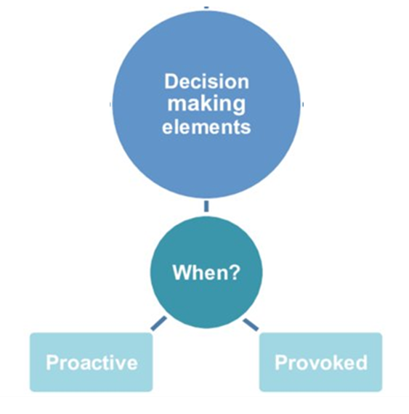
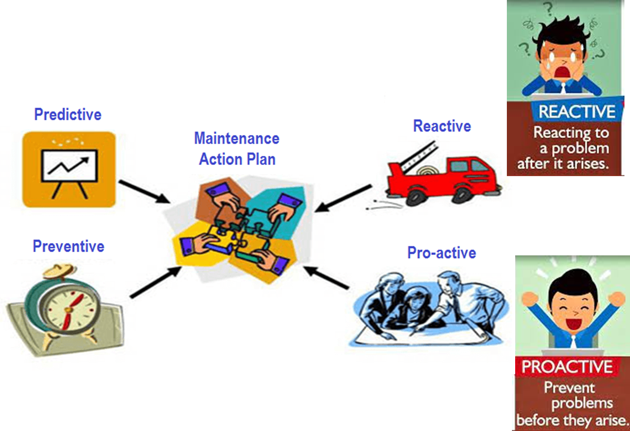
When?
EXAMPLE
Plant Equipment Maintenance Action Plan
Notes:
KLP: Understand the first element in the decision-making process: WHEN
Another element is the timing (WHEN) doing execution or operation, for example, and you could have either a proactive approach or a reactive (provided) approach.
Here is an example, say you have plant with 1000 of machines, and you need to put together a maintenance plan for all the equipment.
You can fix a machine when it breaks (REACTIVE MODE) or you can fix it before it breaks (PROACTIVE MODE).
You do not know exactly when the machine is going to fail, but FOR SURE, you know that when the machine breaks the plant may go into total or partial shutdown, meaning losing production.
Typically, plant applies PREVENTIVE maintenance for those machines that are either expensive to fix or are in the operation critical path.
However, you can-do PREDICTIVE maintenance by analyzing existing equipment maintenance data and predict potential failures, so you know WHEN you can do the maintenance and not lose production. It is not only WHEN, but also WHICH piece of equipment needs maintenance. Predictive maintenance can save a lot of money!!!
Another example could be in the health care industry, you want to know “WHEN” there will be lots of patients, “WHEN” there could be an allergy medicine will have it highest demand.
All of these are elements you analyze as part of the decision-making process.
Next Slide

Slide 9
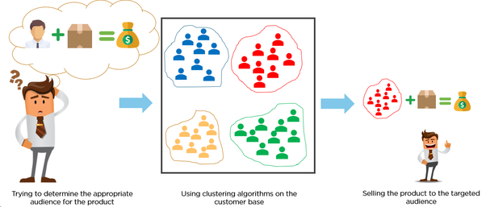
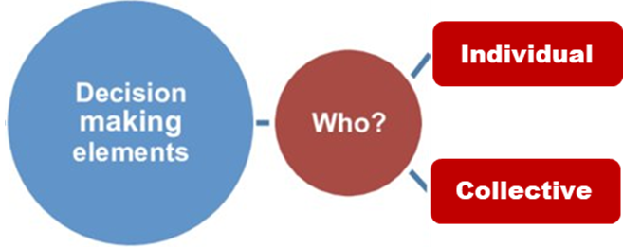
Who or Which?
Notes:
KLP: Understand the first element in the decision-making process: Who or Which
Let us go with Who or Which.
Here comes the same problem we have shown before where you want to reach a targeted audience or group of audiences for promotion, such as:
Selling products
Selecting beneficiaries for a socially disadvantage group of people
Your clients who may have potentials of leaving your service or subscription or stop using your product
Group of customers on who you have high cost but less profit or
Educational institutions who needs financial support to improve pass rate
Again, AI technology will help you making this type of decision.

Slide 10
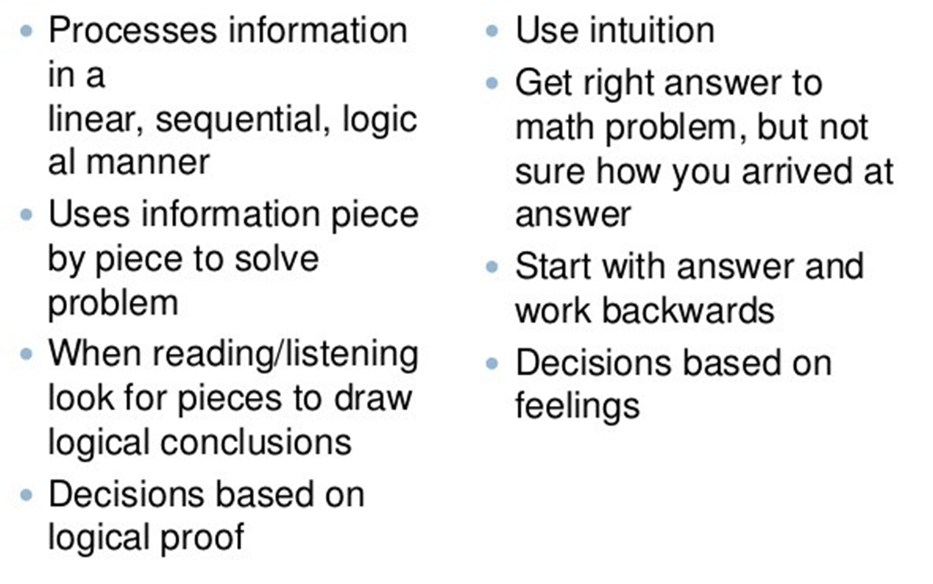
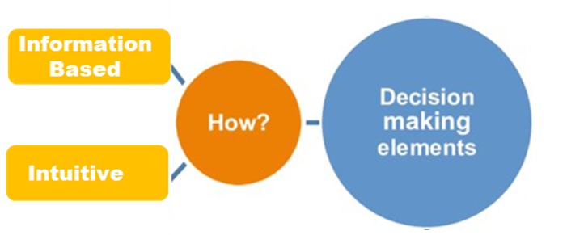
How??
AI
Information Based
Intuitive
Notes:
KLP: Understand the first element in the decision-making process: How
Let us talk little bit about How
What do we mean with HOW in the decision-making process:
How to get to What, Who and When is also a part of decision.
How is nothing but a process of reaching an outcome.
Typically, there are mainly TWO of solving HOW:
One is information based, where you use your INTELLIGENCE by:
Absorbing the information with your senses (reading, listening, etc.)
Processing the information with your brain (linearly, sequentially, logically, to, etc. You name your way to process the information!!)
Mapping the information in clusters for better understanding
Building a logical path to arrive to a decision.
and the other intuitive, where you use your guts (or EXPERIENCE) to:
Get the right answer, but not sure if it is the correct answer.
Start with the answer to arrive to the facts (bottom-up analysis)
Building an emotional path to arrive to a decision.
Where do you guys think Artificial Intelligence will play a big role in this part of the decision-making process? Information based or Intuitive?
[Click]
Yes. AI helps you mainly in the information-based side of the decision-making process !!
For example, you are in a car manufacturing plant, and there is plenty of history data where in the history data for both good and “LEMON” cars, such as different operational parameter like pressure, temperature, etc.
You can do a PREDICTIVE analysis (using the IDARE AutoML Tool) see what parameter or process may lead the car to be bad or good, by following the information-based process described above.
Next slide

Slide 11
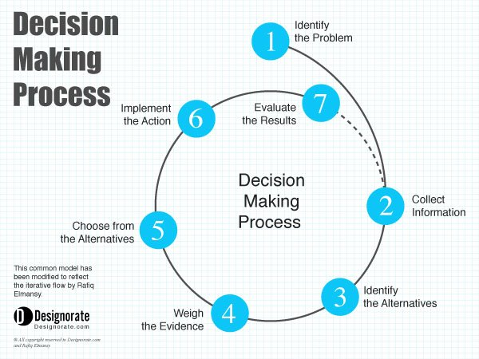
Where AI Helps in Decision Making Process?
AI
Notes:
KLP: Understand WHERE in the decision-making process AI is utilized the most.
This graph shows the decision-making process as an ITERATIVE process with the following steps:
Identify the problem
Collect information
Identify alternatives
Weight the evidence
Choose from Alternatives
Implement the action
Evaluate the results
Where do YOU think AI helps the most in the decision-making process?
[click]
AI play key role in these 3 steps specially:
Weighing the evidence (feature importance) and
Choosing an alternative( classifications problems).
Next slide.

Slide 12

Notes:
KLP: Revisit the importance of AI.
We talked a lot about the decision-making process, and NOT a lot about AI.
Why? Because it is most important to solver the problem by making a decision based on critical and analytical thinking!!
An Artificial Intelligence is one of the tools, or the TECHNOLOGY to achieve that. That is why comes after decision-making.
Different people have different understandings of what is AI. Everybody has their own perspective, and everybody is right about it.
However, let us present to you what WE UNDERSTAND OF WHAT AI IS!!!
[click]

Slide 13
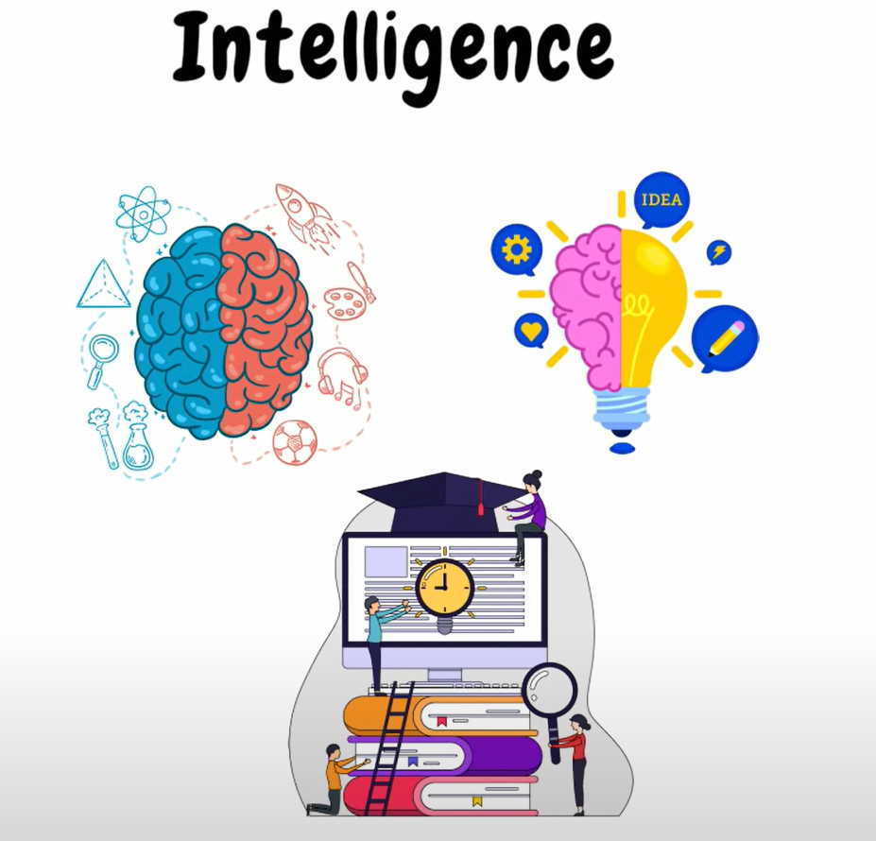
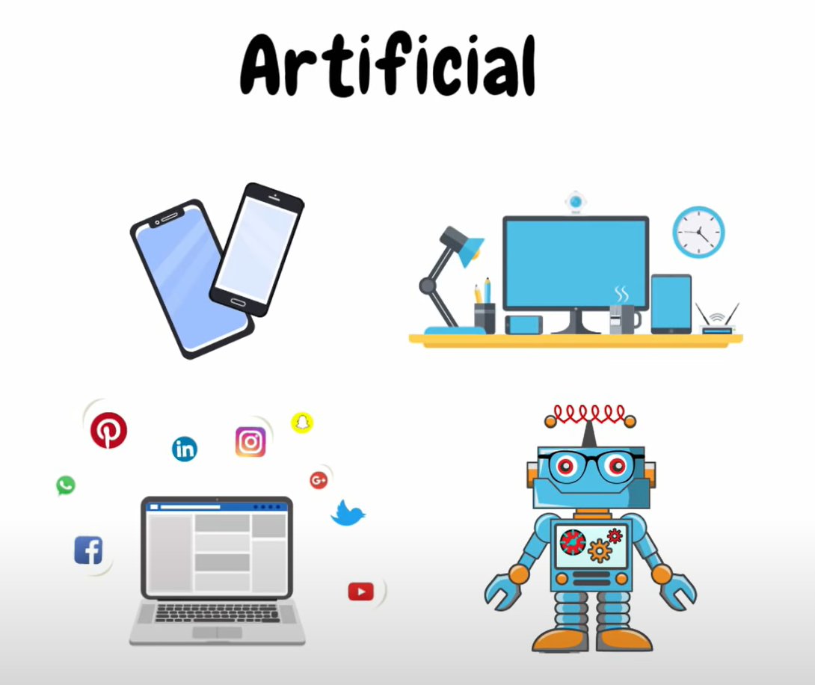
When Machine Does These
We Call it
Understand
Think
Experience
Notes:
KLP: Present IDARE’s definition of AI
For us at IDARE we understand that:
Human INTELLIGENCE is the process where we, as HUMAN BEINGS:
Gather experience every moment, [click]
That experience is in fact information or data
That information or data is creating history, which is stored in our brains.
With the help of our brains, we: [click]
THINK ABOUT IT
UNDERSTAND IT (be aware of it)
Make decisions
[click]
When such process of thinking and understanding is copied by machines or algorithms, the it is called machined or artificial, hence artificial intelligence.
In the next slide then, we will see HOW THE MACHINE WORKS.
Next slide.

Slide 14


How AI Works!!
Data Modeling/Processing
Knowledge
from Past
In the form of Data
Machine Learning
Learns
Understand
Quantify
Classify
Provide Decision
Automation
Notes:
KLP: Understand HOW AI works!!
How AI works:
Past experiences or knowledge is gathered in the form of data, and it uploaded into the machine.
The machine then LEARNS (or understands the data) by using some mathematical or machine learning algorithm.
The algorithm (utilizing the knowledge of the data) quantifies or classifies the information as and output or a prediction.
The output (or prediction) can directly be a decision point or it can be easily derived to be a decisions.
This whole process performed by machine (which processes the data, learns from the data, and provide predictions from the data which can be automated) is called the AI process.
Other important definitions and terms:
The process of making knowledge into the form of data (by processing data) is called data modelling
The process of understanding the data using machine learning and providing decision output using mathematical algorithm is called machine learning
After that post processing the machine learning output to create further decisions or actions automatically is called automation work.
All these 3 process together make Artificial Intelligence system.
So let us clearly differentiate between AI and ML.

Slide 15


Artificial Intelligence (AI) is a process of creating intelligence for decision making by extracting knowledge from history, where learning is done by machine instead of human
What is Machine Learning Algorithms
Machine Learning (ML)
Are mathematical algorithms that helps learning from history, extract knowledge then either classifies or quantifies
(Part of AI)
Notes:
KLP: Understand the difference between AI and ML
So let us clearly differentiate between AI and ML.
AI is a technology or process of creating intelligence for decision making by extracting knowledge from history, where learning is done by machine instead of human.
And Machine learnings are some mathematical algorithms that helps to understand from data, extract knowledge and provide quantity or classifications as output.
Next Slide

Slide 16
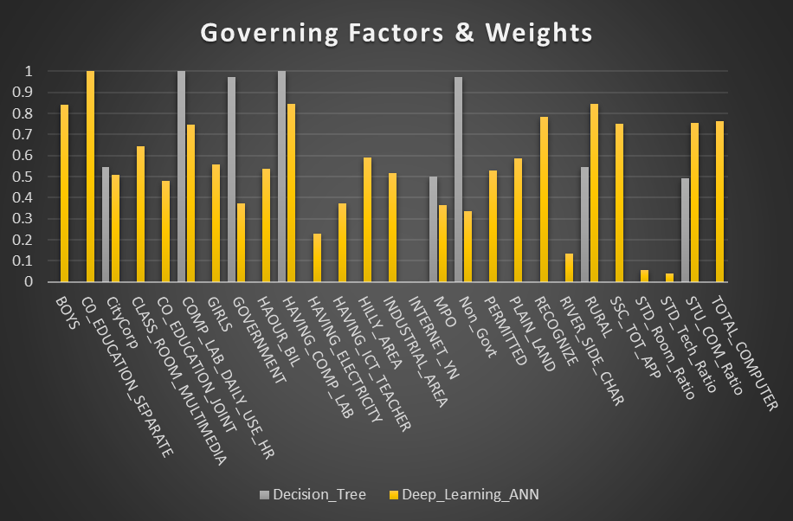
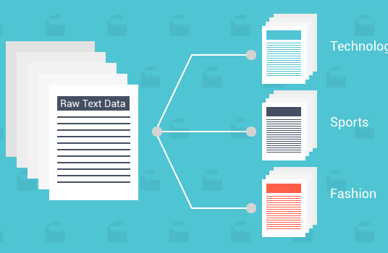
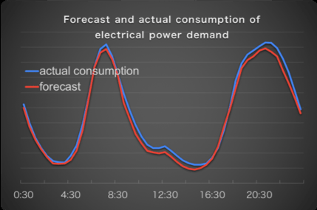

Machine learning is the mathematical algorithms that work like
human thinking process that can do following:
Variable Importance/ Feature Importance
Identify important reasons/factors
Low pass rate, high power demand, disease progression
Classification
Classify or Categorization of Elements
Classifies or identifies behaviors, products, people etc. that are similar
Quantification or Regression
Predicts Number Or Forecasting
Demands, life-deaths, probability, performance
Pattern Recognition (Classification)
Recognizes from patterns from signal, images, videos or voices
Can detect anomaly in a signal or detect different patterns, Can recognize an object from image/video/voices
Notes:
KLP: Understand WHAT Machine Learning does
What exactly machine learning provide as outputs?
Identify importance of variables or data behind an outcome, including indication of root cause of an event
Classifies or categorizes behaviors, profiles, people or characteristics. It is called classifications
Quantify amounts, numbers or time such as forecasts. It is also called regressions.
Recognizes objects, patterns from voices images, videos which is another form of classification, but it is treated a different “animal”.

Slide 17
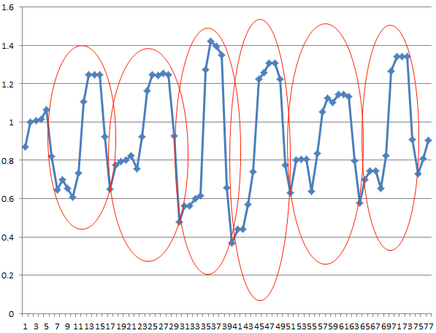
Machine learning is the mathematical algorithms that work like
human thinking process that can do following:
Intelligence AI provides
Identifying root cause of a problem (How)
Diagnosis of a problem in system ( Who)
Separate elements/phenomena in a system (Who)
Quantifying time of a problem may occur (When)
Quantifying the magnitude of a problem (How)
Feature Importance
Classification
Pattern Recognition
Regression
Using intelligence augments critical decision making in various business
Notes:
KLP: Understand WHAT Machine Learning does by “being” intelligent.
Machine learning outputs are INTEGRATED within the machine, because now the machine is intelligent and can do the following:
Feature importance helps you identify root cause of a problem, which could be “How” as sometimes we say how did this happen.
Classification helps detection or diagnosis of the problem and predicting such problem for a running system, answers “Who Which sometimes How”
Pattern recognition also helps diagnosis and predicting a problem or anomaly in the system to answer “who, which”
Regression for quantifying numbers, sometimes it is time to answer when, sometimes it predicts number to understand “How” big your problem is
All the above outputs answers what, when, how and who, which are the elements of the decision making processs.
Therefore, in closing….
next slide

Slide 18
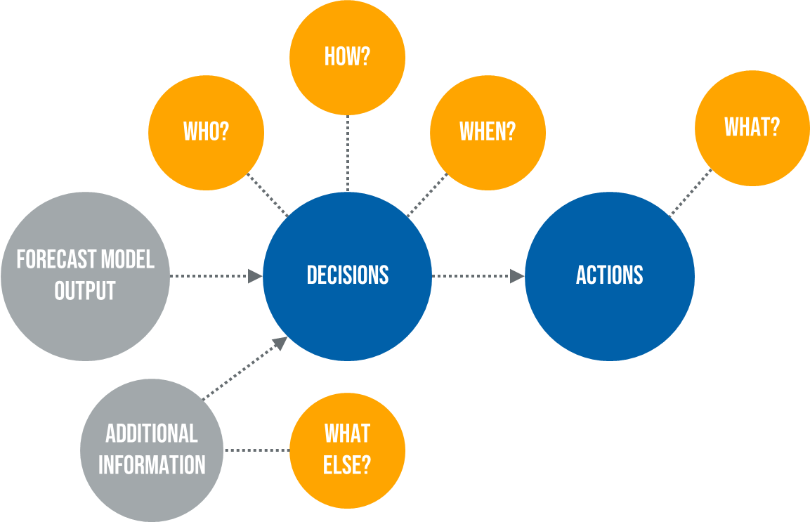


SUMMARY
AI Output
AI augments decision making process
Notes:
KLP: Integrate the decision-making process with Artificial Intelligence
Now we can see the WHOLE PICTURE.
On the left side the typical decision-making process, on the right side the different elements of the process.
Now we add the data, the machine learning, and the AI outputs to that process.
Now we see how machine learning turns information into AI output that leads to a decision then actions.
This concludes the foundation of the course to helps you understand the importance and relevance of AI in the decision-making process

Slide 19


